Slide 1

PROCESS MINING BY CELONIS ACADEMY INDUSTRY INTERNSHIP B.TECH (CSE) 2nd Year 3rd Semester Name : Abhinav Kumar Choudhary Admission No. : 21SCSE1011615 Section : 21 To : Dr. ARVIND KUMAR

Slide 2

I N T R O
WHAT IS PROCE SS MINING?
Process mining is a paradigm shift, that changes decision-making and organizational change processes.
Facts (objective), decisions are not based on assumptions or subjective analysis
Full (complete), decisions are not based on samples or assumptions
For real (true comparison), comparisons between departments are not based on debatable industry benchmarks
Fast (digital data), decisions are not based on interviews, but digital transaction data
2

Slide 3

Why are processes often not transparent?
Processes change - Processes are not a rigid construct, but change continuously. They are readapted for customers, have to comply with new laws or are reorganized due to reorganizations. These adaptations are occasionally not recorded in the process documentation.
As mentioned in the introduction, in many companies there is a big difference between the corporate processes assumed by the employees and the reality of the processes. The main causes of this are as follows:
Differences in perception - employees usually do not go through a process as it is intended in the optimal case. They often spend time repeating certain work steps or incorporate additional steps that are not actually intended in the process described.
Lack of overall view of process chains - Employees often only have insights into certain sub-processes. They do not know in detail which processes come before and after their work step or still follow. This often leads to a lack of an overall view of the process chain.
Subjectivity - Everyone has a subjective picture of a workflow, depending on their role and perspective. This is one of the reasons why it is so difficult to discover the "as-is" process in a classic workshop or interview-based setting.
Exceptions prove the rule - exceptions in certain process flows play an important role. Not all processes follow the so-called happy path, where there are no special features in the process flow that could complicate it.
3

Slide 4








Process Mining creates transparency
Process mining is a process management technique. It aims to discover, monitor and improve process flows by extracting readily available knowledge from information systems event logs. Process mining provides companies with complete visibility into how processes really work. With these insights, companies can then identify opportunities for process optimization.
Process mining involves several steps here:
The organization mining
The simulation models - simulation models are constructed automatically
The model repair
The automated process discovery - extraction of process models from an event log
The conformity check - monitoring deviations by comparing model and protocol
The case prediction
The history-based recommendation
4

Slide 5



How process mining works
It's all about event logs. When humans and software robots work with IT systems, their activities are recorded by those systems. Process mining reads this data, converts it into an event log, and then creates visualizations of the end-to-end process, along with insightful analytics.
An event log contains each step performed during the process (the activity), the time at which the event occurred (the timestamp), and for which instance of the process (the case ID).
Using this event log, algorithms generate a process model that shows the process as it really is - including the timing of each step and all variations in process flow, process deviations, and exceptions - bottlenecks, workarounds, and inefficient workflows - rather than as it is perceived to be.
Other data science methods can be applied to further improve this model. The result is then used for process discovery, conformance testing and process improvement.
The visualization capabilities built into advanced process mining tools help companies focus on what should be optimized, how to do it, and what the return on their efforts will be. Organizations are able to immediately understand the impact of proposed process changes or automation - including the cost saved and effort required. They can easily build and prioritize their automation pipeline or process optimization efforts.
Advanced process mining solutions continuously monitor and measure results, so companies immediately know if they are on track or off base. They also get a complete audit trail for compliance purposes.
5

Slide 6
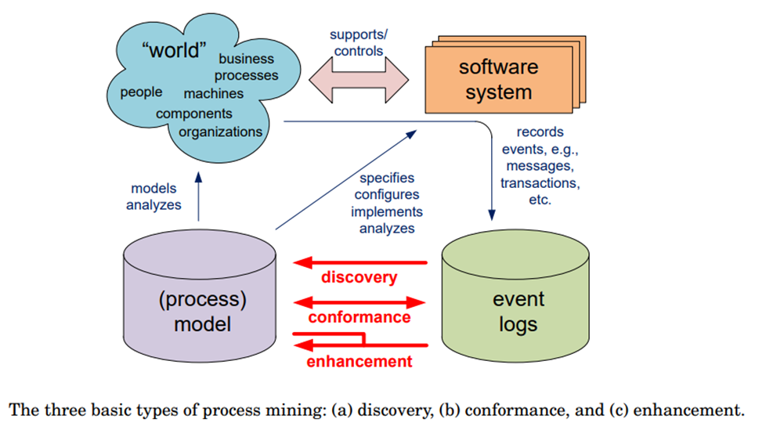

Slide 7






The Mining Algorithm - The Main Component of Process Mining
The deterministic algorithm was one of the first algorithms capable of handling concurrency. It takes an event log as input and computes the order relation of the events contained in the log.
The mining algorithm determines how process models are created. The best known categories are:
Heuristic Algorithms: Heuristic mining also uses deterministic algorithms. However, they refer to the frequency of events and traces to reconstruct a process model. A common problem in process mining is that real-world processes are very complex and their discovery leads to complex models. This complexity can be reduced by neglecting rare paths in the models.
Deterministic algorithms
Heuristic algorithms
Genetic algorithms
Genetic Algorithms: They use an evolutionary approach that mimics the process of natural evolution. They are not deterministic. Genetic mining algorithms follow four steps: Initialization, Selection, Reproduction, and Termination.
Deterministic algorithms: Determinism means that an algorithm produces only defined and reproducible results. It always delivers the same result for the same input.
7

Slide 8




How to start a process mining project
1
2
3
4
Determine problem
Identify the data
Setting up a pilot project
Accept truth
Identify the problem of
Identify the data sources that need to be fully understood to address the business process issues under consideration.
Identify the applications and systems that need to provide
Set up a pilot project to prove the potential value of a process mining solution.
Ensure that the project can be executed relatively quickly and
Accepting analysis,
the results of the as process mining
importance to the business that can realistically be addressed with process mining.
Determine the business value of solving the problem and what
provides, among other things, a clear picture based on facts. Process mining can be just the
deliver specific, measurable results that everyone in the
right tool to validate the uncomfortable realities of the business process environment,
metrics to use to measure success.
feeds of event data for continuous visibility into end- to-end processes.
organization can understand.
and also a constructive springboard to ask the right questions that fix the problems
10

Slide 9


These areas benefit from process mining!
Process mining is beneficial for many situations in large organizations. Areas where process mining can be actively applied include the following:
Automation - This is about understanding the actual processes, variations and opportunities to be successful in RPA projects.
The reporting of complete process KPIs and dashboards for a given process.
The Digital Transformation to understand the "big picture" - how businesses operate, what needs to be prioritized and transformed.
Auditing and compliance to promote adherence to agreed-upon procedures, rules, and regulations.
Process improvement to identify bottlenecks and other symptoms of inefficient processes.
IT and ERP development to support ERP consolidation, new deployments and major version upgrades.

Slide 10



The application of process
mining is manifold
Scaling optimization efforts across multiple business operations and locations and supporting process control through the use of Data.
Simplify compliance, with complete audit trails.
Capture processes anywhere in the enterprise with little human effort.
Delivering the full context and end-to-end perspective required for process improvements.
Identify bottlenecks, deviations, and inefficient processes to be reconsidered or automated.
Identify the most valuable and effective processes for using automation.
Continuous improvements.
monitoring and measurement of

Slide 11



Cross-industry use of process mining
Banking and finance
In the financial sector, it is important to comply with rules and
regulations and to be able to provide evidence of this. By using the event data from the systems, individual cases can also be visualized as a process flow. It can be shown how often deviations occur and what the reason for this non-compliance was.
Telecommunication
Telecommunications is a highly competitive sector worldwide. The
ability to improve operational processes is key to success and profitability. Process mining helps telecom companies gain visibility into geographically dispersed operations, identify bottlenecks, and ensure that customers receive products and services on time.
Process mining can be used for business process management and process improvement in any application and any industry.
Production
In the manufacturing industry, timely and accurate delivery to a customer
is the goal. When a company has multiple factories in different regions, there are usually differences between the reliability of deliveries. It is fairly easy to see that they exist, but it is more difficult to understand exactly where or why they are happening. Process mining can be used to compare the performance of different locations, down to individual process steps, including duration, cost, and the person performing the step. All event data available in the systems is suitable for use. In this way, facts can be generated.

Slide 12




Cross-industry use of process mining
Sales
The success of retail companies is based on efficient
operations. Logistics, warehousing, forecasting, order management,
Healthcare
As data about patient experiences and outcomes increases, so
do the risks around maintaining population health and individual patient outcomes. For healthcare organizations facing an exponential increase in data, process mining helps deliver efficient and high-quality end-to-end patient journeys, from before the first doctor visit, through treatment, to completed treatment cases.
business
and supplier management are the foundation for an excellent
Process
customer experience throughout the customer lifecycle.
mining provides visibility into all of these interconnected processes and offers an understanding of bottlenecks and faulty interfaces.
Data-driven fact-based process mining results focus development efforts on the areas that matter most and deliver the highest business results.
Services
The business logic of service companies is to achieve higher operational excellence, i.e. lower costs, than their customers for the processes outsourced to them. Process mining is an important tool for improving the efficiency of a service company by ensuring harmonized processes and finding causes for process problems and inefficiencies.

Slide 13


Benefits of Process Mining
Save time and increase work capacity
Finding process bottlenecks
Process bottlenecks are difficult to uncover through BPM and process mapping workshops. People have a gut feeling about what might be wrong or inefficient, but they lack fact-based evidence. They need data to back up their assumptions, and that's where process mining comes to the rescue.
Traditionally, the management and optimization of business processes is a very labor-intensive area that requires a lot of time from experts in the organizations.
The growing demand for efficiency and the ability to clearly present results requires modern technologies. Classic BPM approaches are often overwhelmed here because the data they use to support their assumptions has already changed by the time their situation analysis is complete, which in turn renders the analysis useless. When optimizing processes, the most time-consuming part is data collection. Process mining gives companies a head start by automating the data collection part. The basis for understanding the operational situation in an organization is to understand what is actually happening, not what is assumed to be happening. That's what you find out with process mining.
Opinions are replaced by facts
One of the main goals of process mining is to see the big picture of business operations and still be able to track down the root causes of deviations, bottlenecks or process variations.

Slide 14


Celonis
Founded in 2011 by three university students, CelonisCelonis helps companies achieve process excellence through its platform by eliminating operational friction with their Intelligent Business Cloud platform. In addition to user-friendly process discovery, analysis and compliance testing capabilities, the platform offers a dedicated Transformation Center for KPI monitoring. A key strength is Celonis' comprehensive approach to process improvement, which includes a Python-based machine learning workbench for predictive insights, an AI-powered action engine for intelligent process recommendations, and process automation to automate workflows. Celonis provides a highly scalable and secure platform, offers multiple deployment options, and supports many databases and systems for data extraction. Celonis recently launched Operational Applications. These are role-based applications that automate tasks, prioritize workflows and provide guidance for achieving business goals by leveraging business context, artificial intelligence and the central process mining engine.

Slide 15


